Slide 1
Exploratory Data Analysis of COVID Clinical Trials

Slide 2
Purpose
Objective
To analyze trends, enrollment patterns, and key characteristics in a dataset of COVID-19 clinical trials.
Gain insights into trial phases, study types, and enrollment variations over time.

Slide 3
Details of Data
1. Source: COVID-19 clinical trials dataset, with information on trial phases, enrollment, study types, and dates..
2. Key Variables:
Status: Indicates current trial status (e.g., Recruiting, Completed).
Phases: Clinical trial phase (Phase 1, 2, 3, or Phase 4).
Enrollment: Number of participants enrolled in each trial.
Study Type: Type of study (Interventional, Observational).
Start Date: Date when the trial began.
3. Shape: Initial dataset contained 5783 rows and 27 columns.

Slide 4
Data Cleaning and Preprocessing
Handling Missing Data: Dropped columns with over 90% missing values (e.g., Results First Posted, Study Documents).
Data Type Conversion: Converted Start Date and other date columns to datetime format for time series analysis.
Outlier Handling: Applied a 99th percentile filter on Enrollment to remove extreme values, making the analysis more insightful.

Slide 5
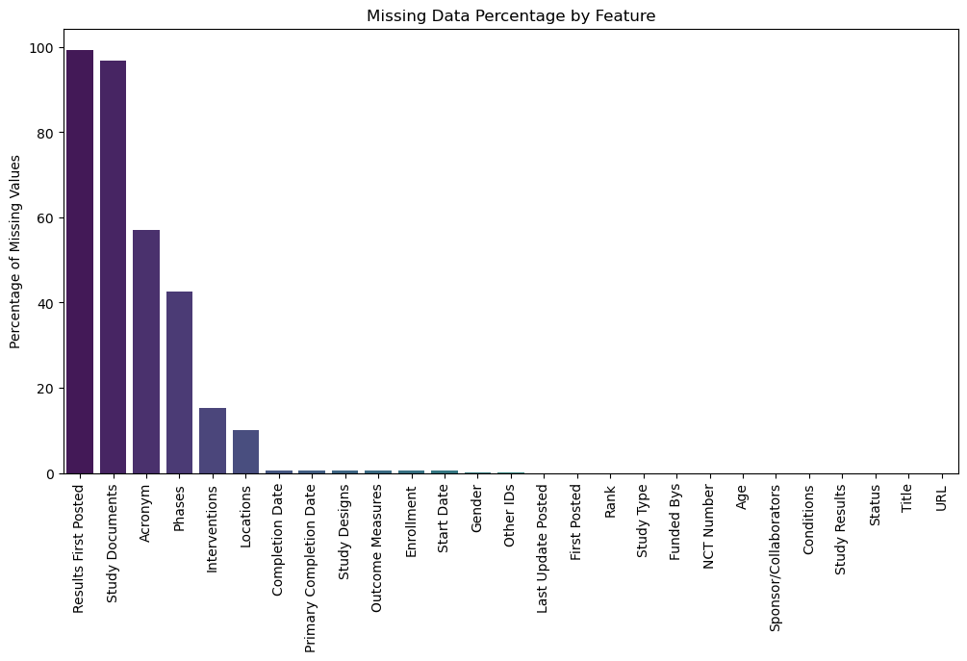
Missing Data Analysis
Insights:
Significant missing data in columns Results First Posted and Study Documents, which were dropped.
Other columns had minimal missing values and were retained for analysis.

Slide 6
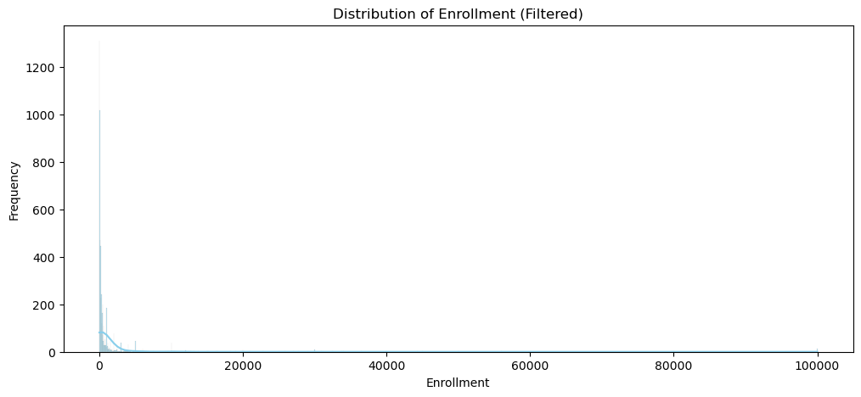
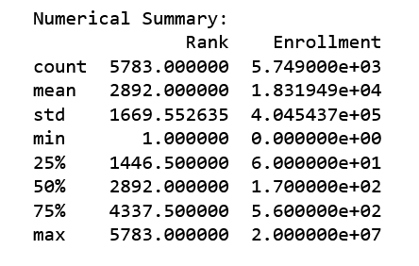
Univariate Analysis: Numerical Data
Insights:
Skewed distribution with a few high outliers.
Most trials have lower enrollment, indicating focused studies.

Slide 7
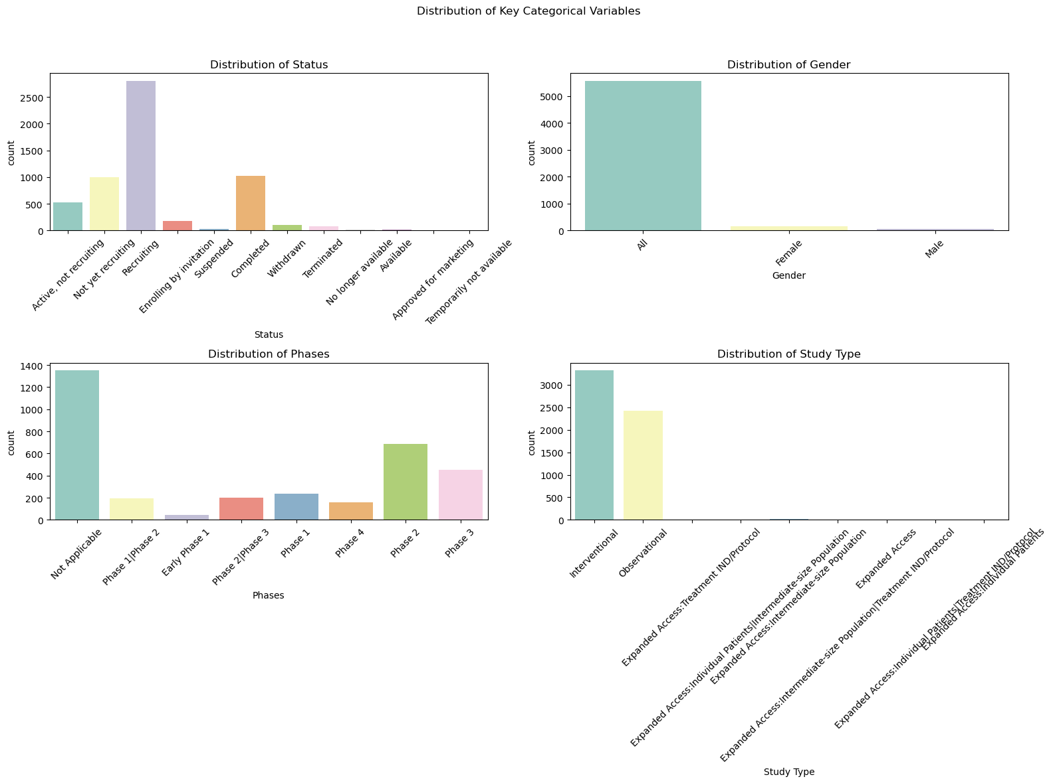
Univariate Analysis: Categorical Data
Insights:
Most trials are in phases 2 and 3, and a significant portion is recruiting.
Interventional studies dominate, with diverse participant demographics.

Slide 8
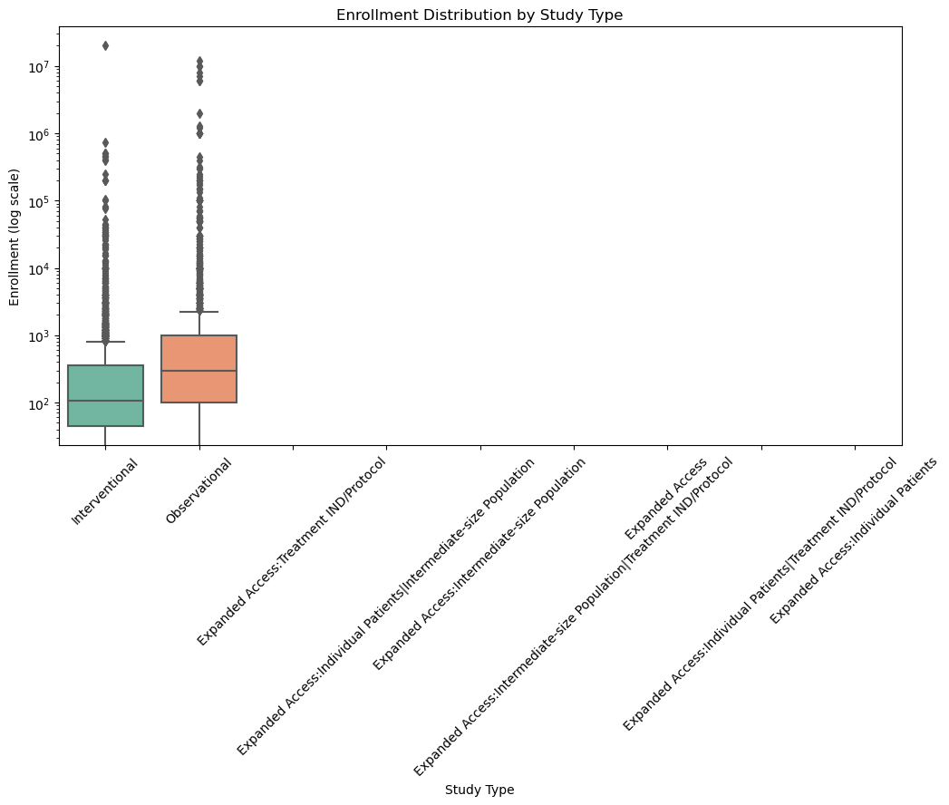
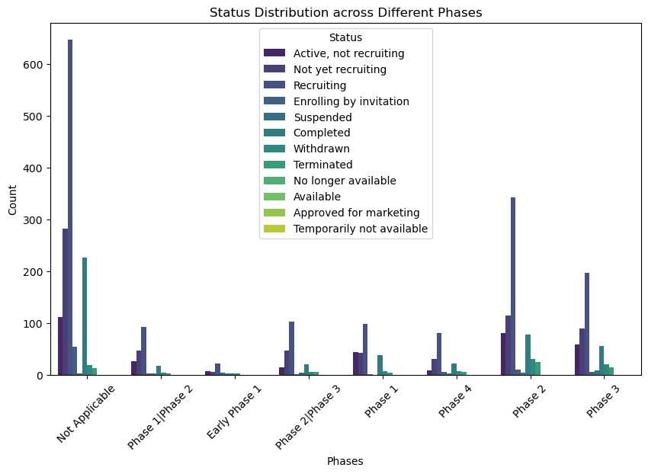
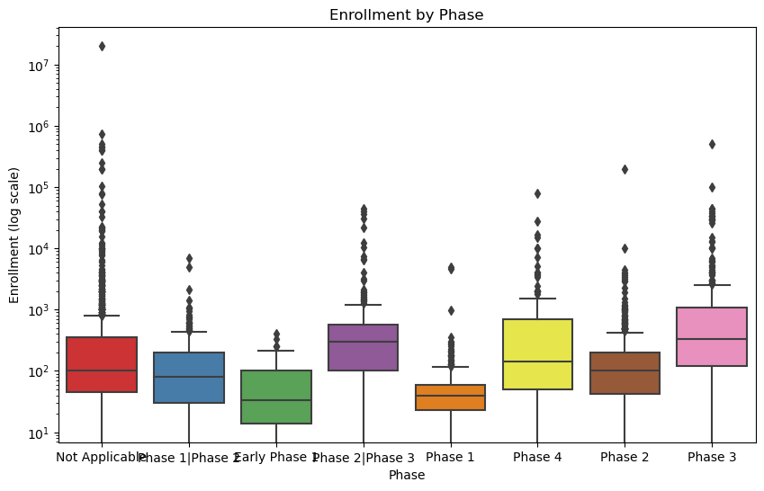
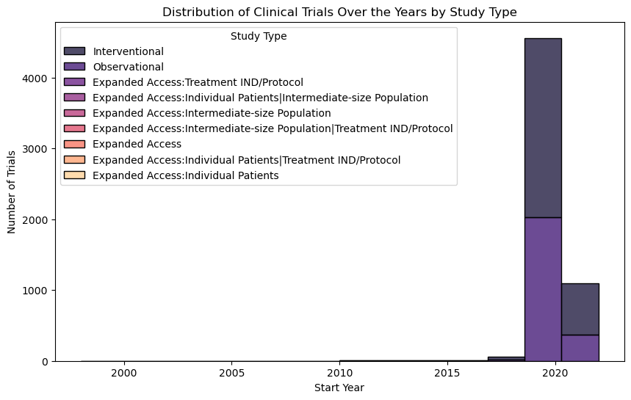
Bivariate Analysis: Key Relationships
Insights:
Higher enrollment in interventional studies may indicate comprehensive trials.
Most recruiting and ongoing studies are in early phases (1-2).

Slide 9
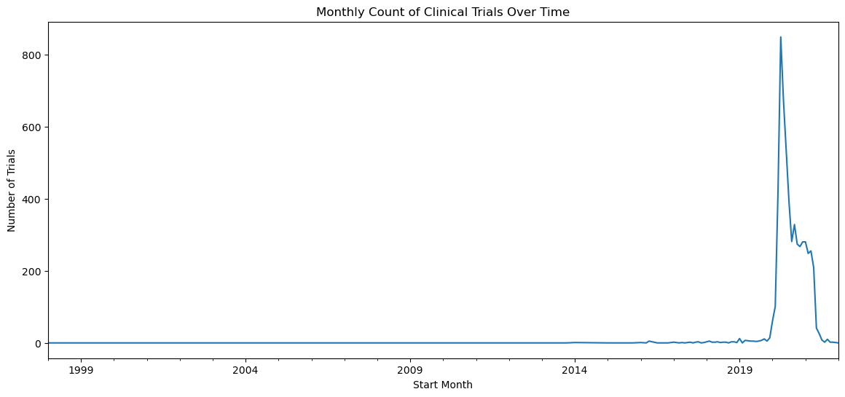
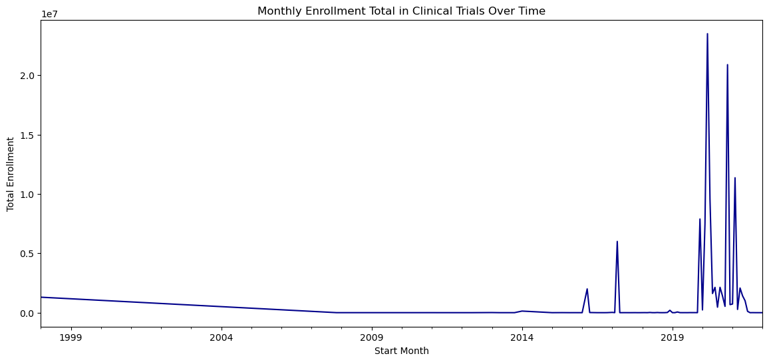
Time Series Analysis
Insights:
Noticeable spikes in trial counts align with significant pandemic periods.
Enrollment fluctuates, possibly due to resource availability and public response.

Slide 10
Thank you

